Slide 1
CMR College of Engineering & Technology
(UGC Autonomous)
Accredited by NAAC with “A+” Grade
Kandlakoya, Medchal Road, Hyderabad-501401
Department of CSE- (AI & ML)
MyFolio- A Resume Builder
PRC-2
BATCH NO: 15
Guided By:
Mrs. A. Deepika
Asst. Prof, CSE-(AI&ML)
Team Members:
20H51A6605 – B. Narayan Singh
20H51A66A6 – G. Rahul
20H51A66B3 – P. Sriteja
CMRCET – CSE (AI& ML)

Slide 2
Introduction
In today’s job market, the resume has become the number one requirement potential employer’s request.
Creating a resume is a bit tedious task for any working professional from any industry. One has to keep it short, simple, and with the latest work experience.
It also involves lot of thinking and understanding for the design process of creating resume which also requires lot of effort.
Hence to reduce the effort we propose MyFolio, A resume builder.
CMRCET – CSE (AI& ML)

Slide 3
Existing Systems
Resume.io
Hackerresume
Disadvantages:
User login required to access the website.
Limited template designs.

Slide 4
Literature review
The Literature explores the importance of a proper structured resume for one’s employment.
It also explores the inclusion of necessary details like personal, educational, professional and so for a resume to be considered.
There are numerous websites which have the facility to create resumes on the internet.
But these websites have the limited features which are not flexible and can not be easily customized as per the needs of the user.

Slide 5
Proposed Method
MyFolio, a web based resume builder which eases the task of creating resumes.
The users have to fill all the necessary details in the forms. With that input a well-structured resume will be generated.
It is Flexible and can be customized easily.
Resumes are stored in the local Storage hence user can access them later on.

Slide 6


Technology Used
The languages we used in developing this project are:
HTML
CSS
JavaScript
ReactJS
Redux
Software Tools Used:
Visual Studio Code
Git, Github

Slide 7
Architecture
Resume
Builder
Resume
Templates
User
Local Storage
Saved Resumes

Slide 8
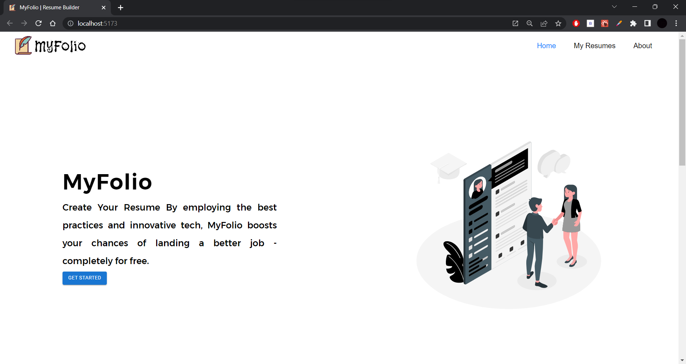
Execution of Code

Slide 9
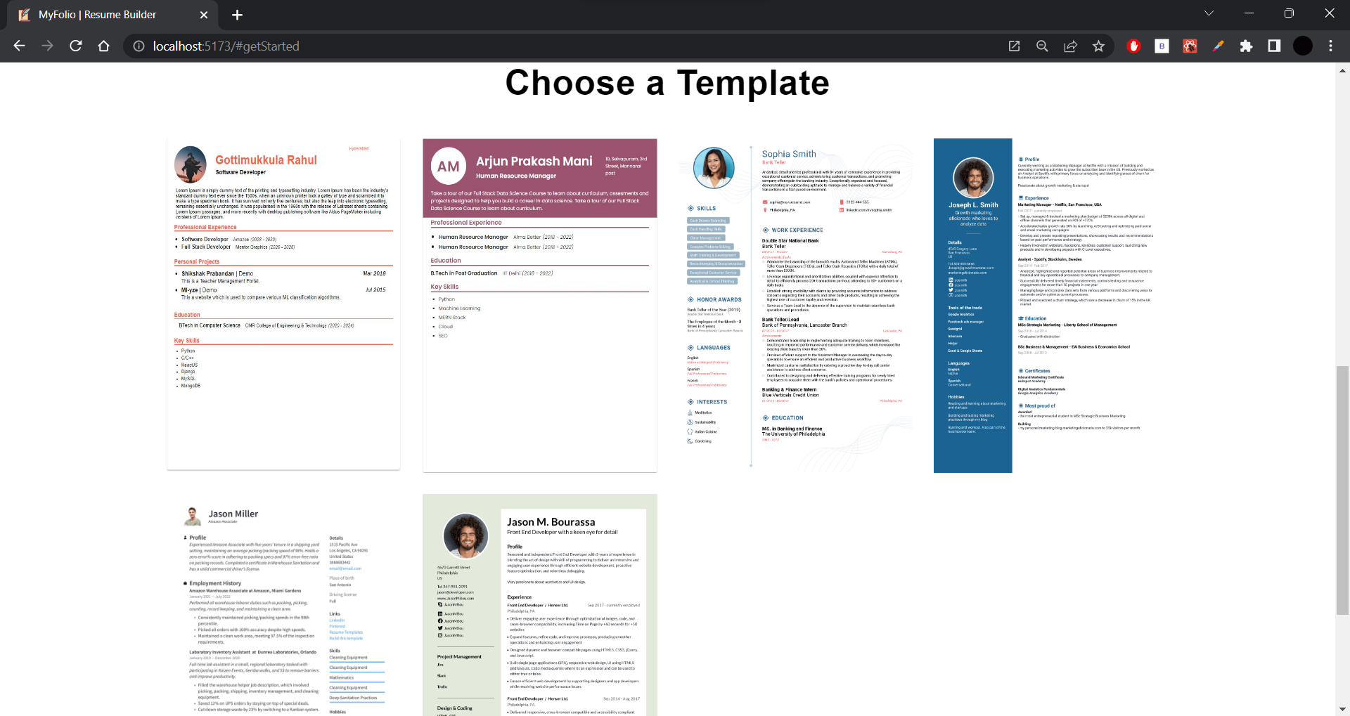

Slide 10
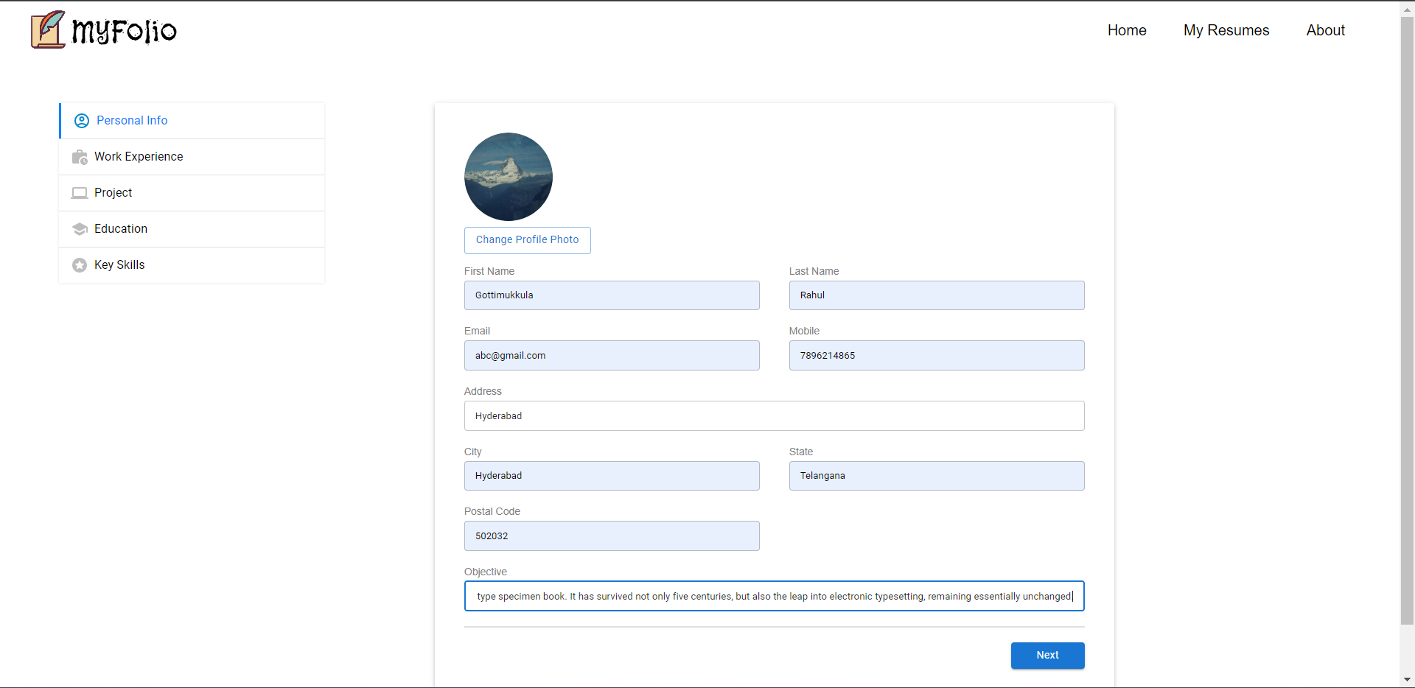

Slide 11
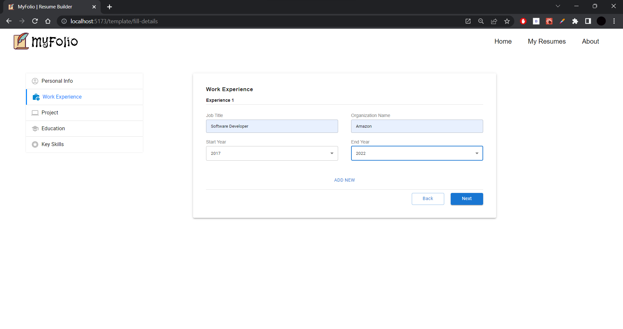

Slide 12
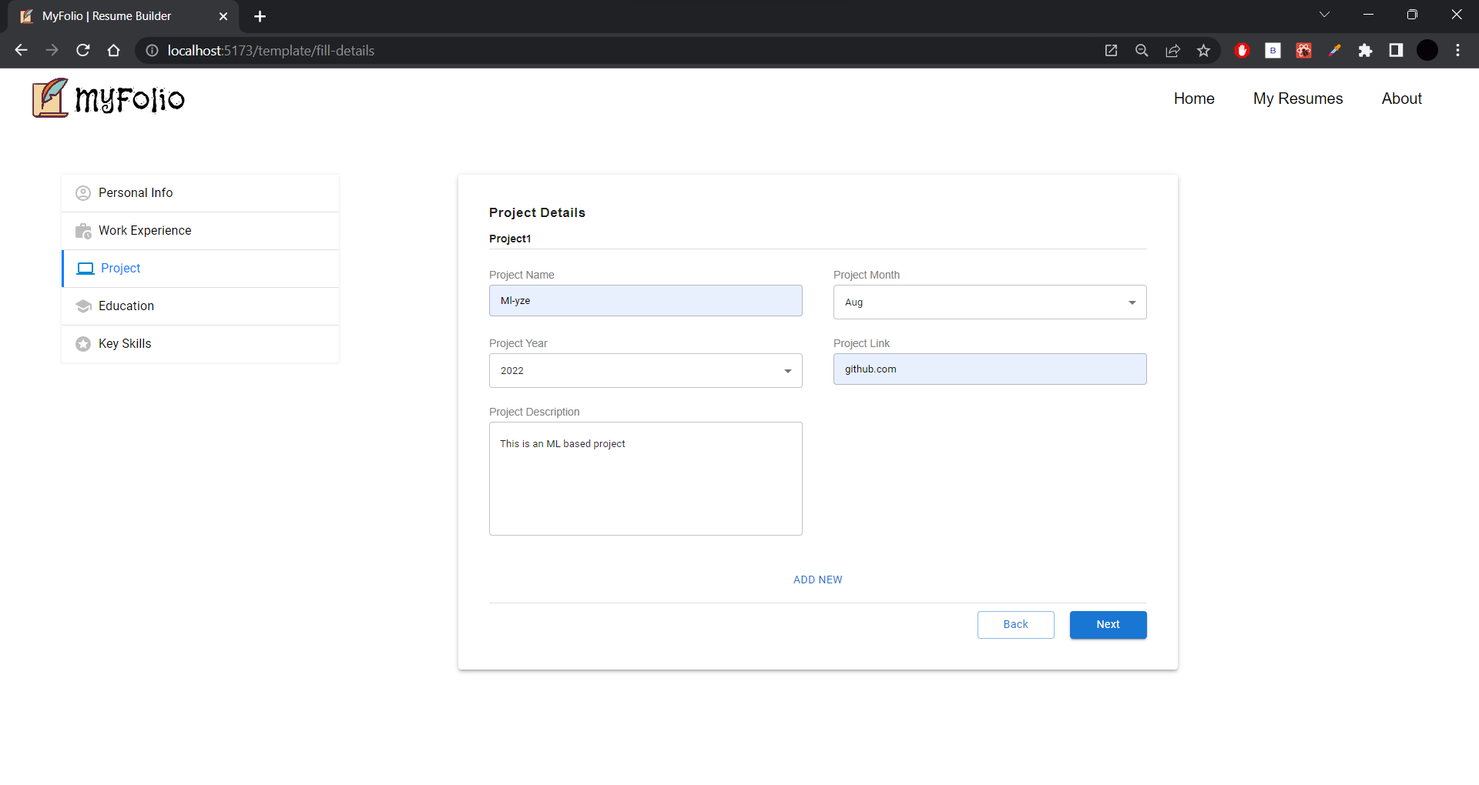

Slide 13
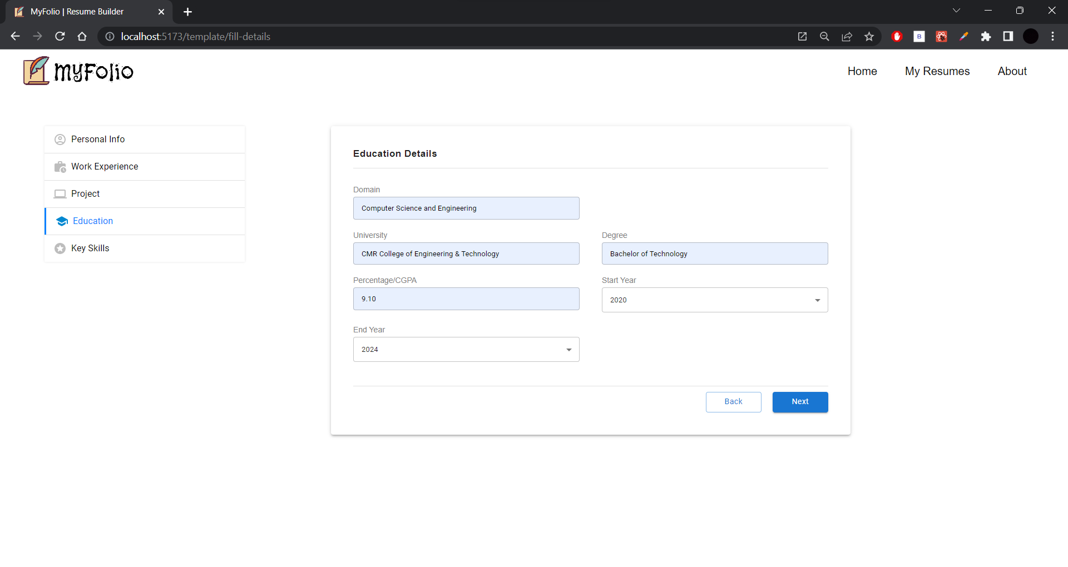

Slide 14
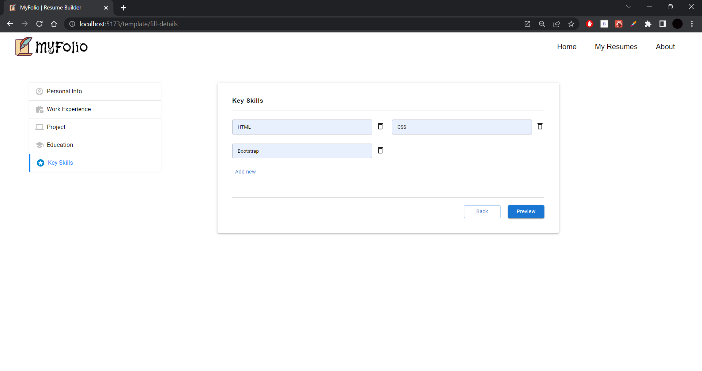

Slide 15
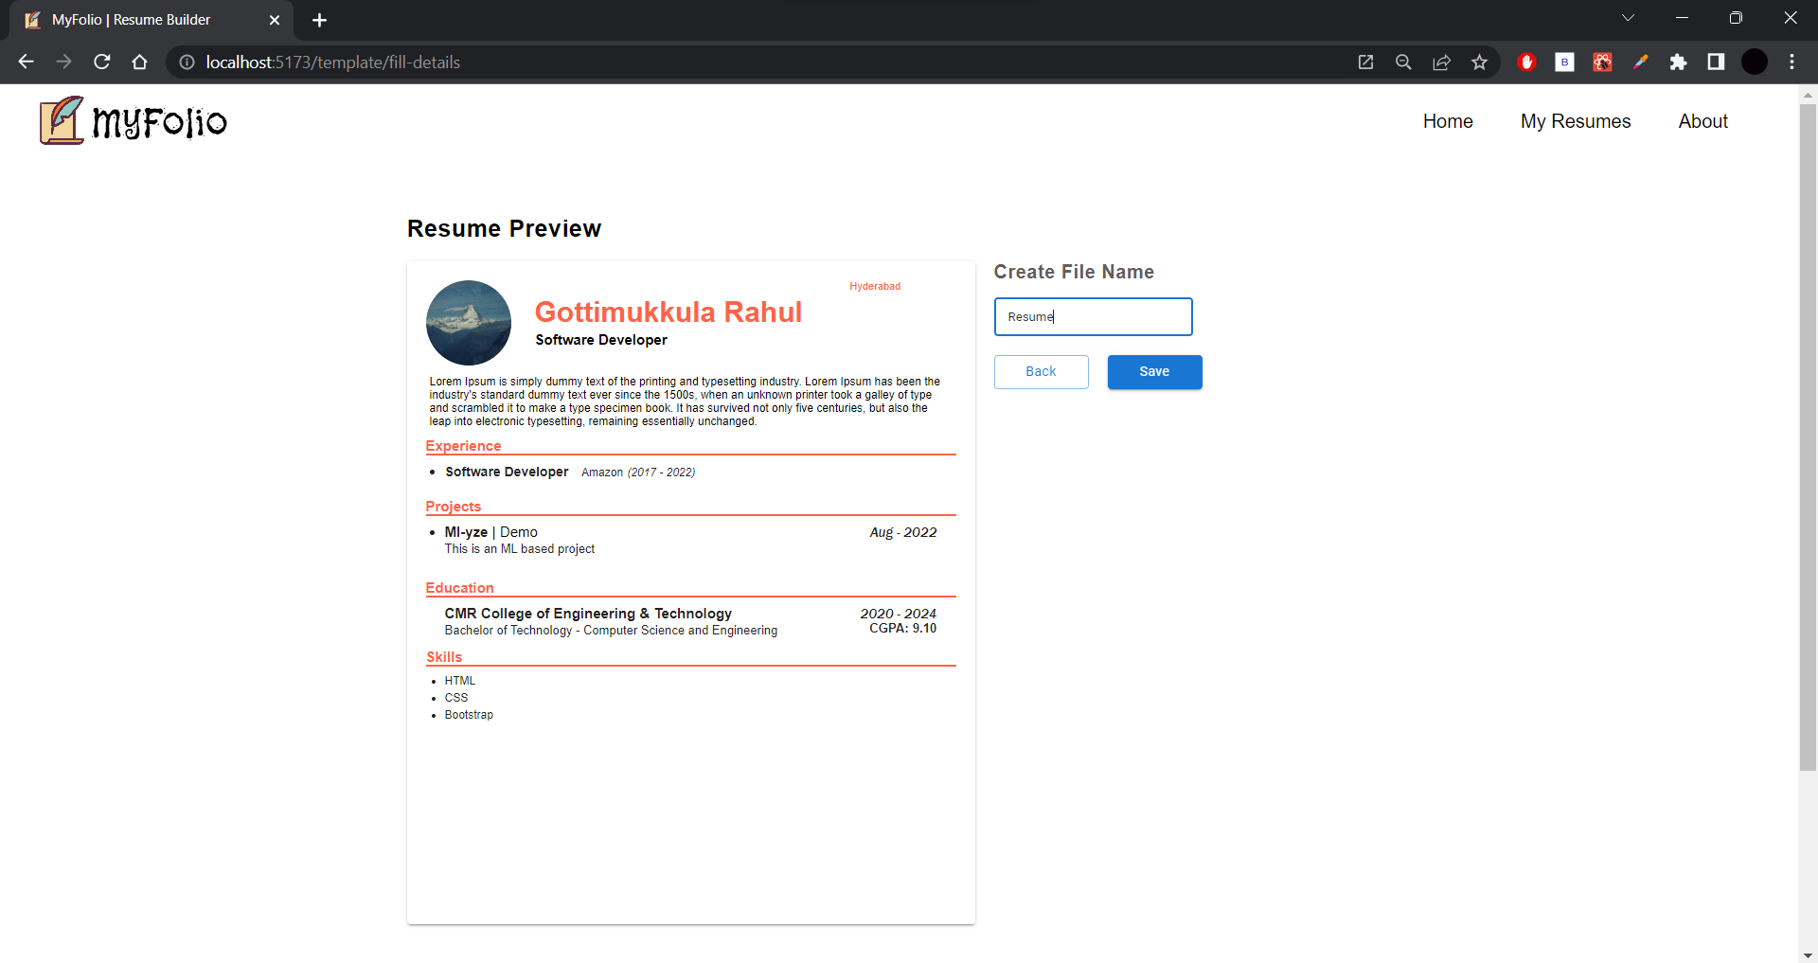
Result and Performance Analysis

Slide 16
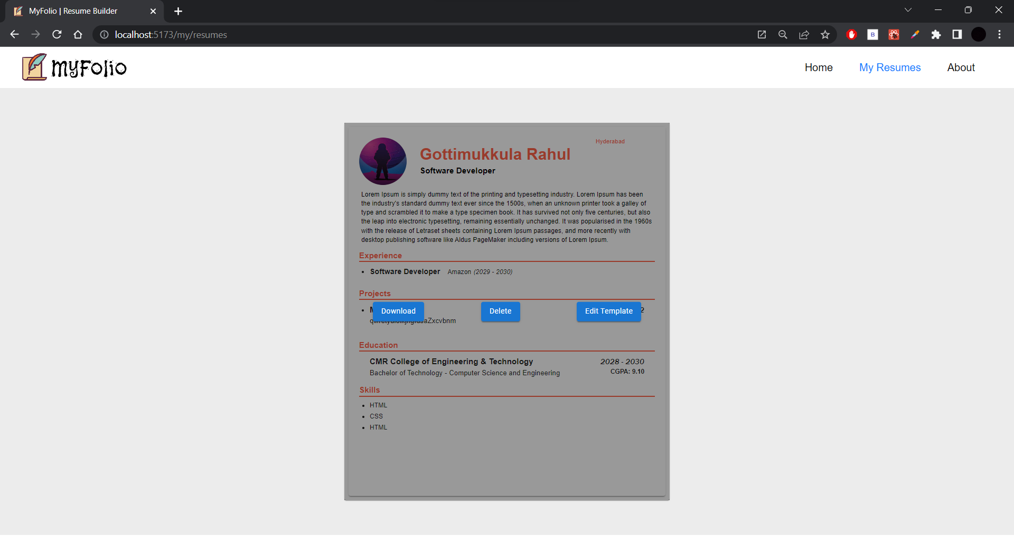
With all the user data the resume is generated and can be downloaded.
The previous resumes can be accessed without any need of login.

Slide 17
Future scope and conclusion
We can also add the backend support for Login Authentication for users.
We can integrate Machine Learning concepts for providing recommendations for the resume profile.
Through MyFolio, we can ease the process of creating well structured resumes.
A user friendly tool which will help many students and job seekers.

